Slide 1

COMPANY BROCHURE
TRIGONA
DIGITAL PVT LTD
Engineering Intelligence | Digital Precision
Your specialist engineering partner for simulation, design and digital delivery — 60 high-value projects completed across six technical verticals.
CFD · FEA · PRODUCT DESIGN · 3D MODELLING · TEKLA · PIPING
Nagpur, Maharashtra, India | Serving clients worldwide

Slide 2




WHO WE ARE
ONE PARTNER, FULL ENGINEERING DEPTH
Trigona Digital is a specialist engineering services and digital product company. We take on the analysis, design and detailing work that is too specialised for in-house teams and too critical for generalist outsourcing — delivered from India at international quality standards, with the communication discipline of a premium consultancy.
35–40% Cost Advantage
Fast Turnaround
Certification-Ready
IP-Safe Engagement
Tier-2 India cost base versus Pune, Bangalore or onshore teams — with equivalent output quality.
Lean senior team, direct engineer access, and timezone overlap with Europe and the Middle East.
ASME BPVC, MIL-SPEC, EN and DIN aligned deliverables; ISO 9001 & 27001 programme underway.
NDA-first model, clear IP transfer clauses, and defence-grade confidentiality practices.
TOOLS WE LIVE IN: ANSYS Fluent & Mechanical, OpenFOAM, Star-CCM+, Abaqus, SolidWorks, Fusion 360, Rhino, Tekla Structures, AutoCAD Plant 3D, AVEVA E3D, SmartPlant.
Trigona Digital Pvt Ltd | Company Brochure

Slide 3

VERTICAL 01 — COMPUTATIONAL FLUID DYNAMICS
CFD SIMULATION
HIGH VALUE PROJECTS COMPLETED
01
EV battery pack thermal management & cooling-plate optimisation
06
Solar thermal collector performance modelling
02
Hydrogen fuel-cell stack thermal simulation
07
Turbomachinery blade aerodynamic analysis
03
Data centre airflow & cooling efficiency modelling
08
Industrial exhaust & pollutant dispersion studies
VALUE TO YOUR BUSINESS
Cut physical prototyping cycles 40–60%, de-risk thermal and fluid designs before tooling is committed, and walk into certification or investor reviews with simulation-backed evidence.
04
HVAC design validation for commercial buildings
09
Electronics enclosure heat-dissipation design
05
Marine propeller & hull hydrodynamic optimisation
10
Wind-load simulation for façades & structures
Trigona Digital Pvt Ltd | Company Brochure

Slide 4
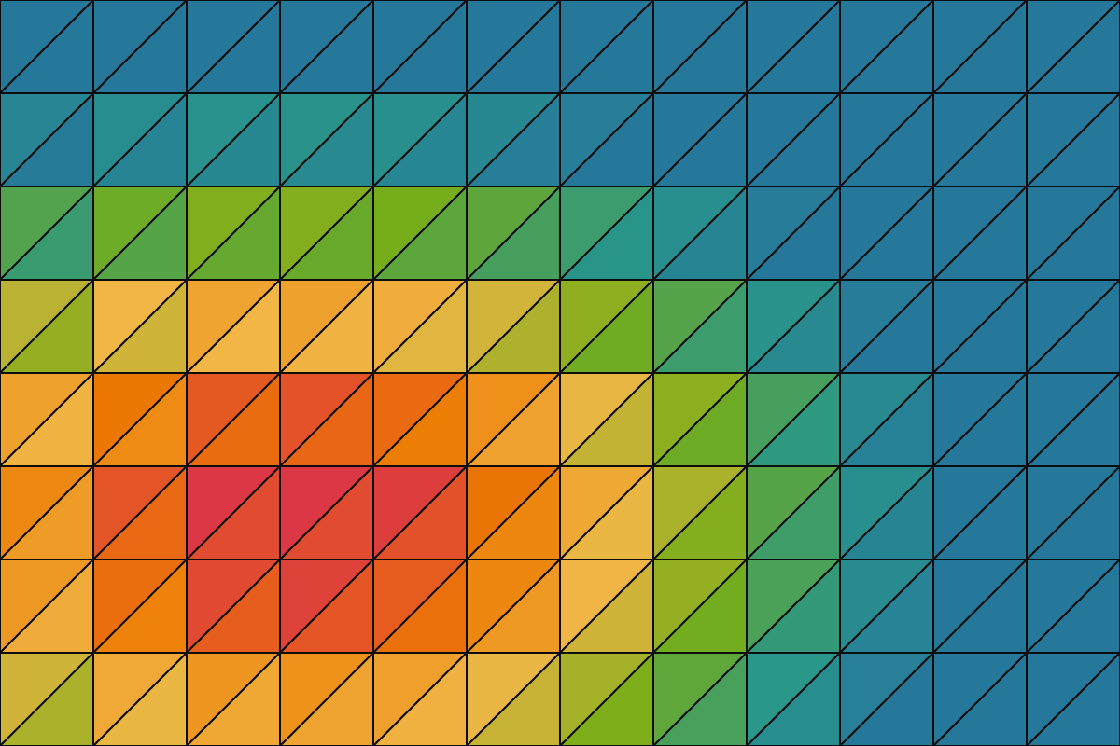
VERTICAL 02 — FINITE ELEMENT ANALYSIS
FEA & STRUCTURAL ANALYSIS
HIGH VALUE PROJECTS COMPLETED
01
Defence equipment recoil & shock analysis (MIL-SPEC)
06
Fatigue & life prediction for rotating equipment
02
Pressure vessel design & assessment per ASME BPVC
07
Seismic qualification of industrial equipment
03
FCC reactor structural integrity assessment
08
Drop, impact & crash simulation of enclosures
VALUE TO YOUR BUSINESS
First-pass certification against ASME, MIL-SPEC and EN standards, avoided field failures and recalls, and lighter, cheaper designs backed by proven safety margins.
04
Medical device structural validation (EN / ISO)
09
Weld & bolted-joint strength verification
05
Hydrofoil & marine structure stress analysis
10
Composite laminate strength & failure analysis
Trigona Digital Pvt Ltd | Company Brochure

Slide 5
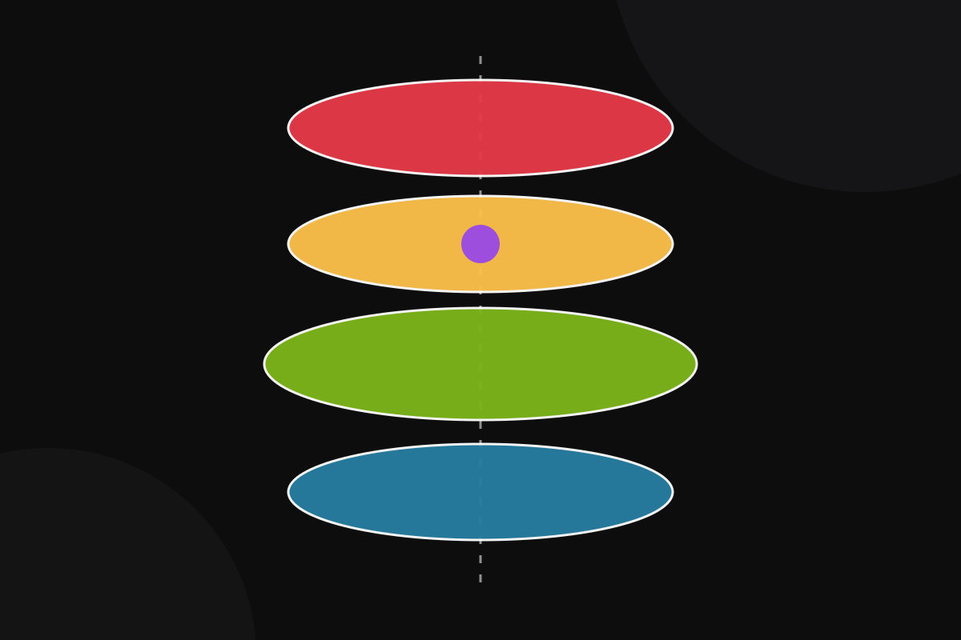
VERTICAL 03 — PRODUCT DESIGN & DEVELOPMENT
PRODUCT DESIGN & DEVELOPMENT
HIGH VALUE PROJECTS COMPLETED
01
PEMF wellness device — concept to production
06
Medical handheld device industrial design
02
Consumer travel accessory NPD with full DFM
07
IoT hardware enclosure — thermal & EMI aware
03
Precision mechanism design & tolerance analysis
08
3D-printed prototyping & pilot-batch coordination
VALUE TO YOUR BUSINESS
Concept to manufacturing-ready in weeks, not quarters. DFM-led design typically cuts unit cost 15–30%, and one accountable partner carries your product from sketch to supplier handoff.
04
Injection-moulded enclosure design (DFM / DFA)
09
Cost-reduction redesign of legacy products
05
Sheet-metal product design for manufacture
10
India manufacturing vendor sourcing & handoff
Trigona Digital Pvt Ltd | Company Brochure

Slide 6

VERTICAL 04 — 3D MODELLING & CAD
3D MODELLING & CAD
HIGH VALUE PROJECTS COMPLETED
01
Reverse engineering — scan to parametric CAD
06
Monthly CAD retainer for manufacturers
02
STL-to-STEP conversion for manufacturing
07
GD&T-compliant manufacturing drawings
03
Large parametric assembly modelling
08
Plant & factory layout modelling
VALUE TO YOUR BUSINESS
Elastic CAD capacity without adding headcount: 24–48 hour turnarounds on retainer, and drawings your shop floor can build from the first time — GD&T-clean, BOM-complete.
04
Legacy 2D-to-3D drawing migration
09
Configurable product-family CAD libraries
05
Photorealistic product rendering & animation
10
As-built documentation & BOM generation
Trigona Digital Pvt Ltd | Company Brochure

Slide 7
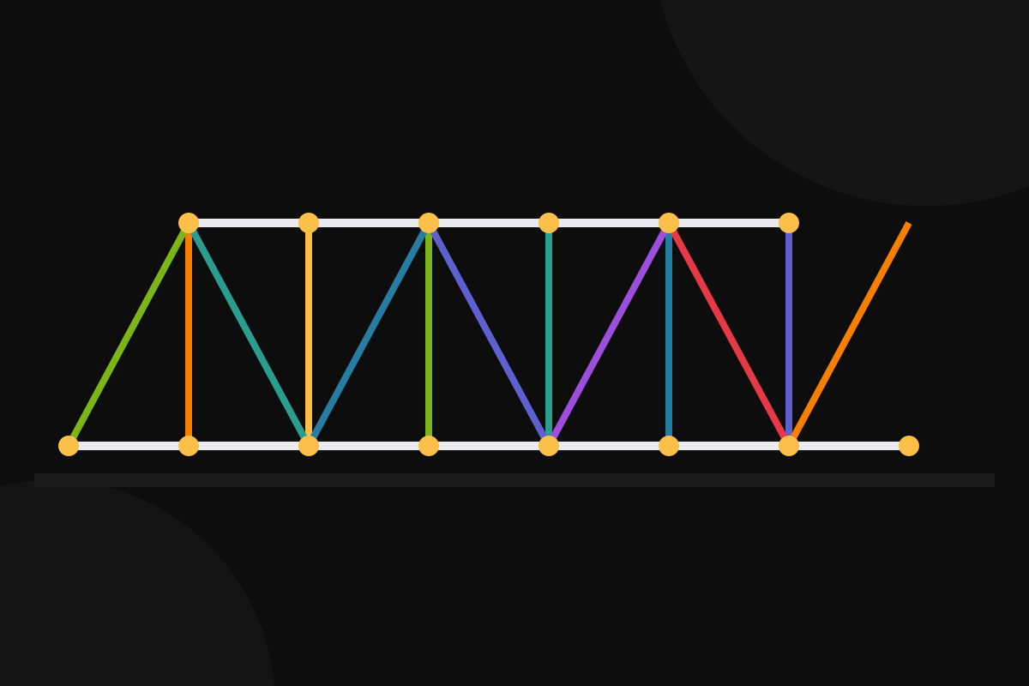
VERTICAL 05 — TEKLA STRUCTURES & BIM
TEKLA STRUCTURES & BIM
HIGH VALUE PROJECTS COMPLETED
01
Structural steel detailing for industrial plants
06
Pre-engineered building (PEB) detailing
02
Bridge steelwork fabrication packages
07
Clash detection & BIM coordination
03
Connection design & verification
08
Erection drawings & sequencing support
VALUE TO YOUR BUSINESS
Fabrication-ready packages that cut rework and site delays, clash-free coordination before steel is cut, and detailing capacity on demand when your project pipeline surges.
04
Shop drawing production for fabricators
09
Long-span & stadium roof steel detailing
05
Rebar detailing for concrete structures
10
Revit–Tekla interoperability workflows
Trigona Digital Pvt Ltd | Company Brochure

Slide 8

VERTICAL 06 — PIPING DESIGN
PIPING DESIGN
HIGH VALUE PROJECTS COMPLETED
01
P&ID development for process plants
06
Pipe stress analysis coordination (CAESAR II)
02
3D piping layout in Plant 3D / AVEVA E3D
07
Water & effluent treatment plant piping
03
Isometric extraction & spool drawings
08
Skid & modular package piping design
VALUE TO YOUR BUSINESS
Compliant, clash-free piping delivered to your company standards — compressing revamp schedules, reducing engineering cost per line, and keeping brownfield surprises off the critical path.
04
LNG & hydrogen piping system design
09
Pipe support design & standardisation
05
Refinery revamp piping engineering (FCC units)
10
Tie-in & brownfield as-built verification
Trigona Digital Pvt Ltd | Company Brochure

Slide 9



CLIENT OUTCOMES
THE VALUE WE ADD TO YOUR COMPANY
Lower Total Engineering Cost
Faster Time-to-Market
De-Risked Compliance
35–40% below onshore and metro-India rates — without the quality trade-off, and with no fixed headcount commitment.
Simulation-led design and DFM discipline compress prototype loops; retainer clients get 24–48h CAD turnarounds.
Deliverables aligned to ASME, MIL-SPEC, EN and DIN — so audits, certifications and export approvals pass first time.
Senior Engineers, Direct Access
IP Protection by Default
One Accountable Partner
You work with the engineers doing the analysis — no account-manager relay, no junior hand-offs.
NDA-first onboarding, clean IP transfer in every contract, and defence-grade confidentiality practices.
Six verticals under one roof: concept, simulation, detailing and manufacturing support without vendor juggling.
Trigona Digital Pvt Ltd | Company Brochure

Slide 10

WAYS OF WORKING
ENGAGEMENT MODELS THAT FIT YOUR NEED
Fixed-Price Project
Hourly Engagement
Monthly Retainer
Defined scope, defined outcome
Flexible specialist capacity
Your embedded engineering team
Best for one-off analyses, NPD phases and detailing packages
Typical tickets ₹1.2L–₹8L (USD 2K–8K)
Milestone-based delivery with review gates
Best for evolving scopes and surge support
80–120 hours/month typical utilisation
Weekly reporting; scale up or down freely
Best for ongoing CAD, detailing and product programmes
₹80K–₹2.5L per month by team size
Priority queue, 24–48h turnarounds, dedicated engineers
EVERY ENGAGEMENT STARTS THE SAME WAY: NDA → scoping call → fixed proposal with timeline and deliverables → kick-off within days.
Trigona Digital Pvt Ltd | Company Brochure

Slide 11
LET'S BUILD SOMETHING PRECISE
START WITH A PILOT PROJECT
Send us one drawing, one failing prototype, or one analysis brief. We'll return a fixed-price proposal with scope, timeline and deliverables — usually within 48 hours.
1 NDA signed
2 Scoping call
3 Fixed proposal
4 Kick-off
Abhishek Bhagwat
Founder & Managing Director · Trigona Digital Pvt Ltd
Nagpur, Maharashtra, India · Also on Upwork (Top Rated)

